Slide 1






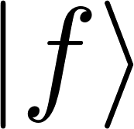


State preparation
Readout
Total latency
FB
Readout
350 ns
440 ns
~895 ns

Slide 2
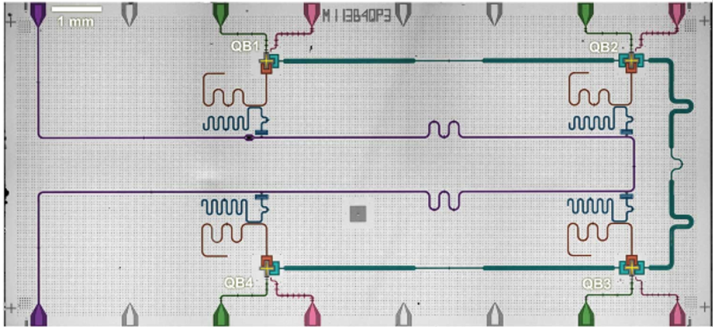

HDAWG
State prep.
Sample
FB
Code word
≈ 895 ns
UHFQA
RO pulse
HDAWG
State prep.
Sample
Threshold
Integr.
Threshold
Integr.
FB
x 2
x 2
Data acq.
Code word
≈ 895 ns
UHFQA
RO pulse
Threshold
Integr.
Threshold
Integr.
x 2
x 2
Data acq.
State preparation
Readout
Total latency
FB
Readout
350 ns
440 ns
≈ 895 ns

Slide 3
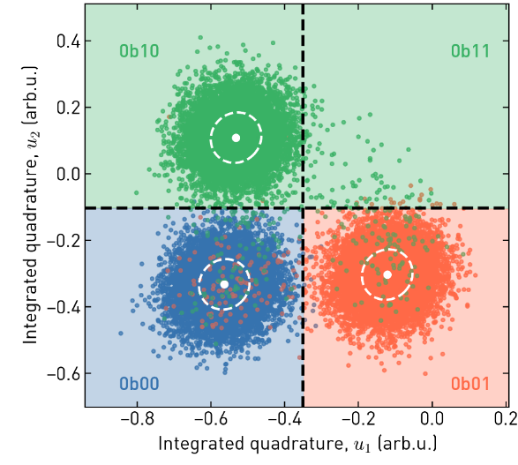
(a)
(b)
HDAWG
State prep.
Sample
FB
Code word
≈ 895 ns
UHFQA
RO pulse
Threshold
Integr.
Threshold
Integr.
x 2
x 2
Data acq.
(c)
State preparation
Readout
Total latency
FB
Readout
350 ns
440 ns
≈ 895 ns

Slide 4
(a)
(b)
HDAWG
State prep.
Sample
FB
Code word
≈ 895 ns
UHFQA
RO pulse
Threshold
Integr.
Threshold
Integr.
x 2
x 2
Data acq.

Slide 5
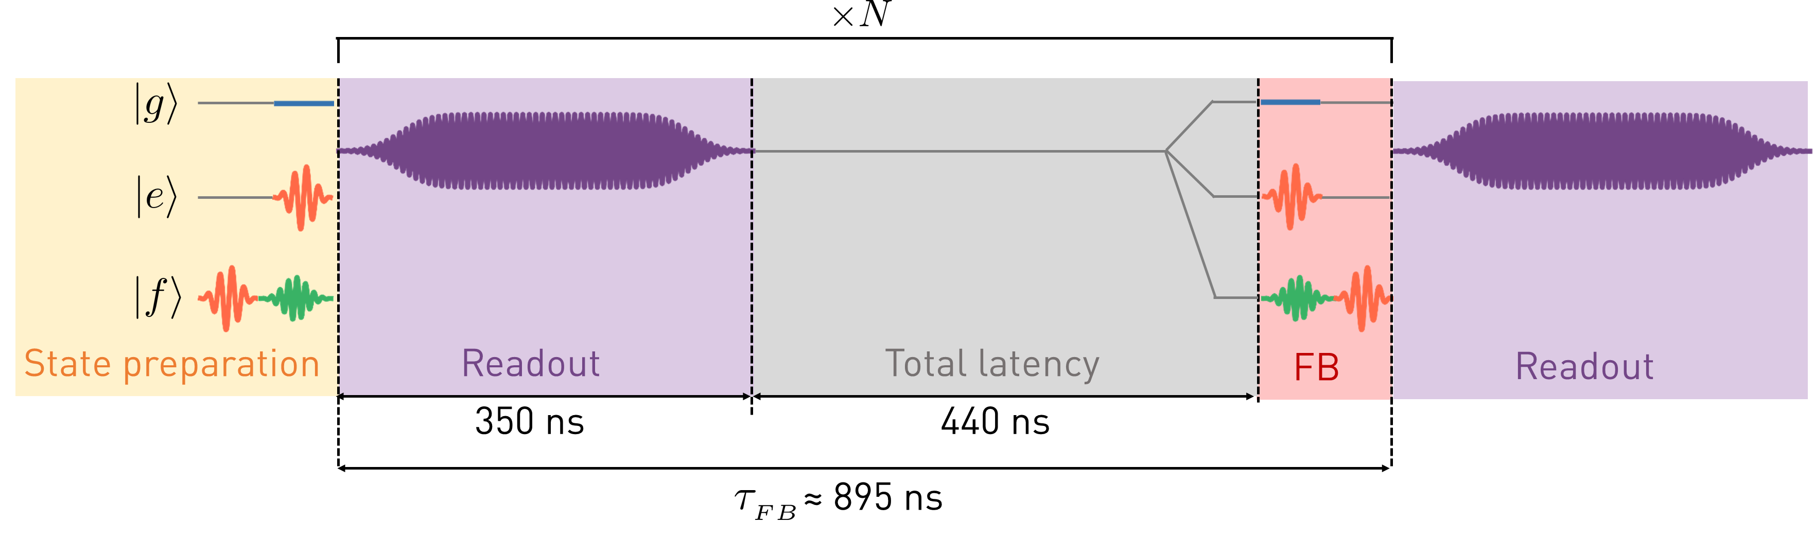
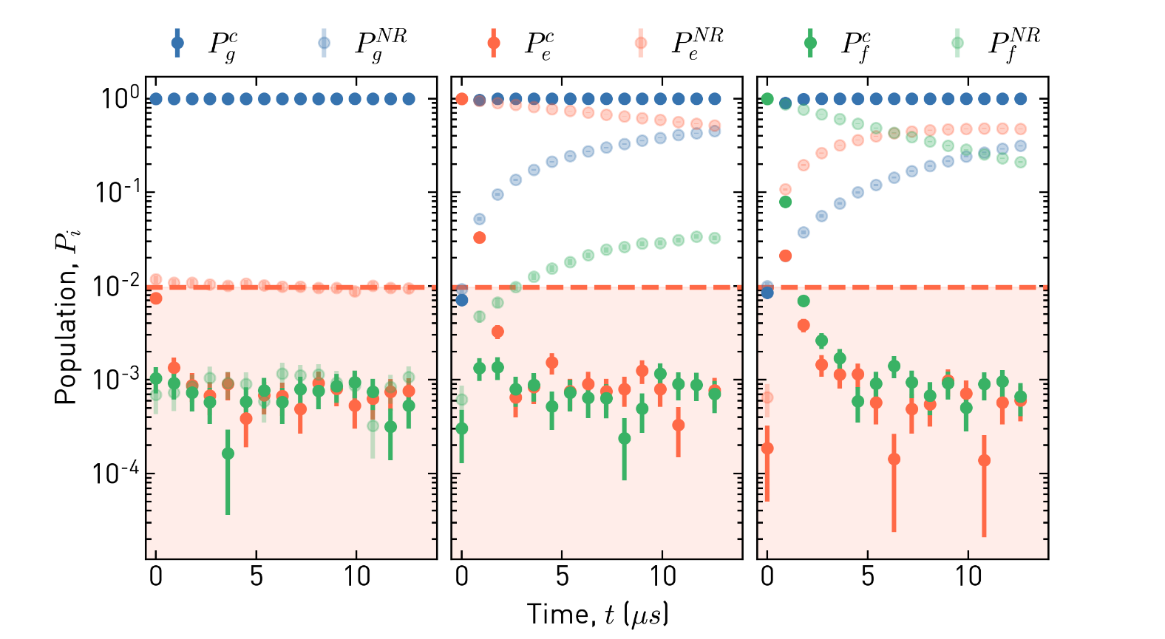
(a)
(b)
(c)
(d)

Slide 6
(a)
(b)
(c)
(d)

Slide 7
CHAPTER 4: C-arb gate

Slide 8
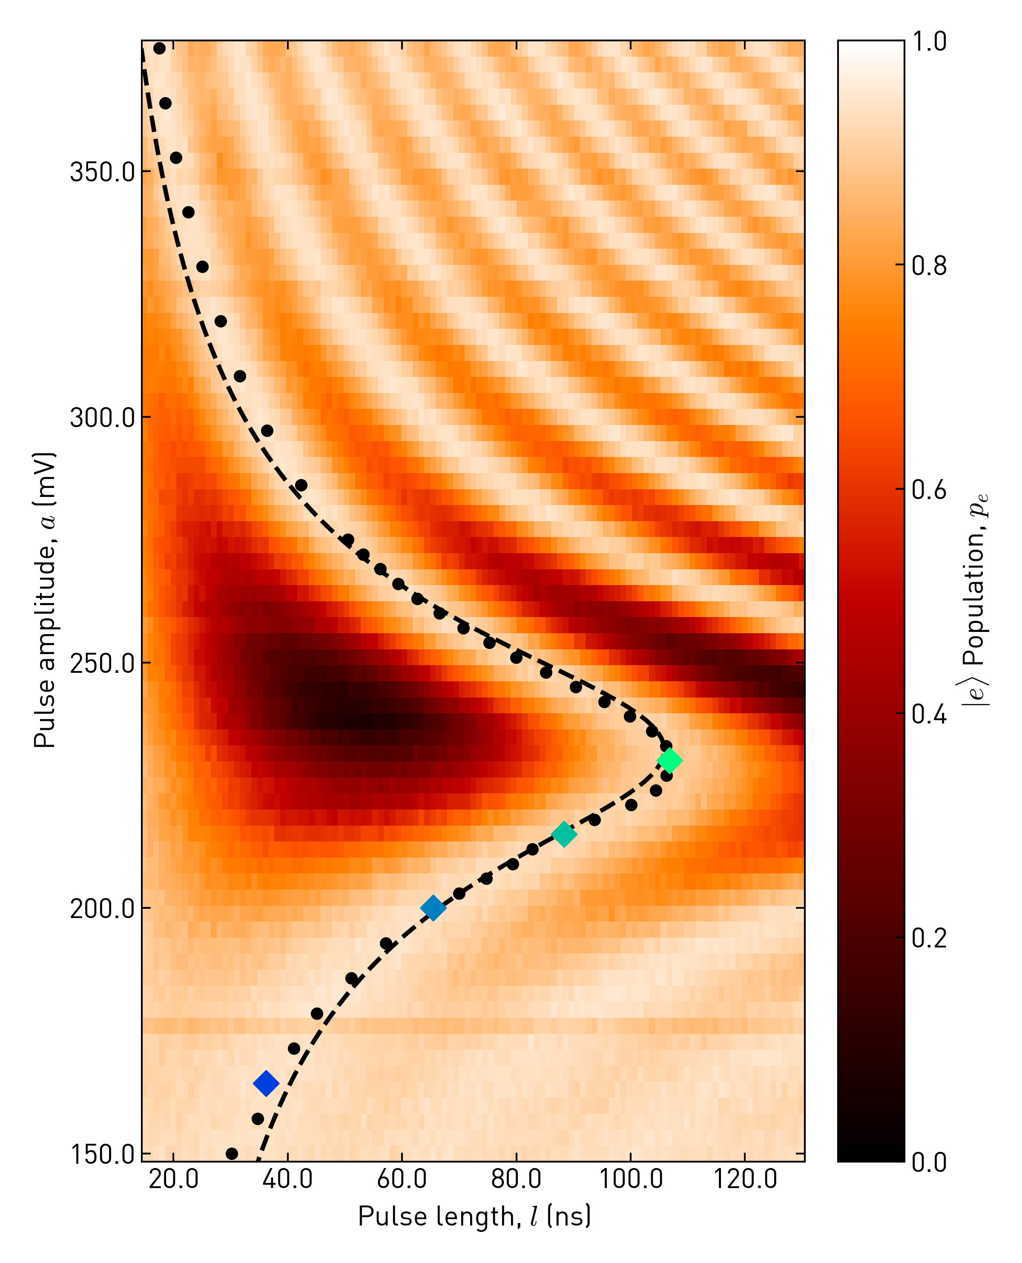
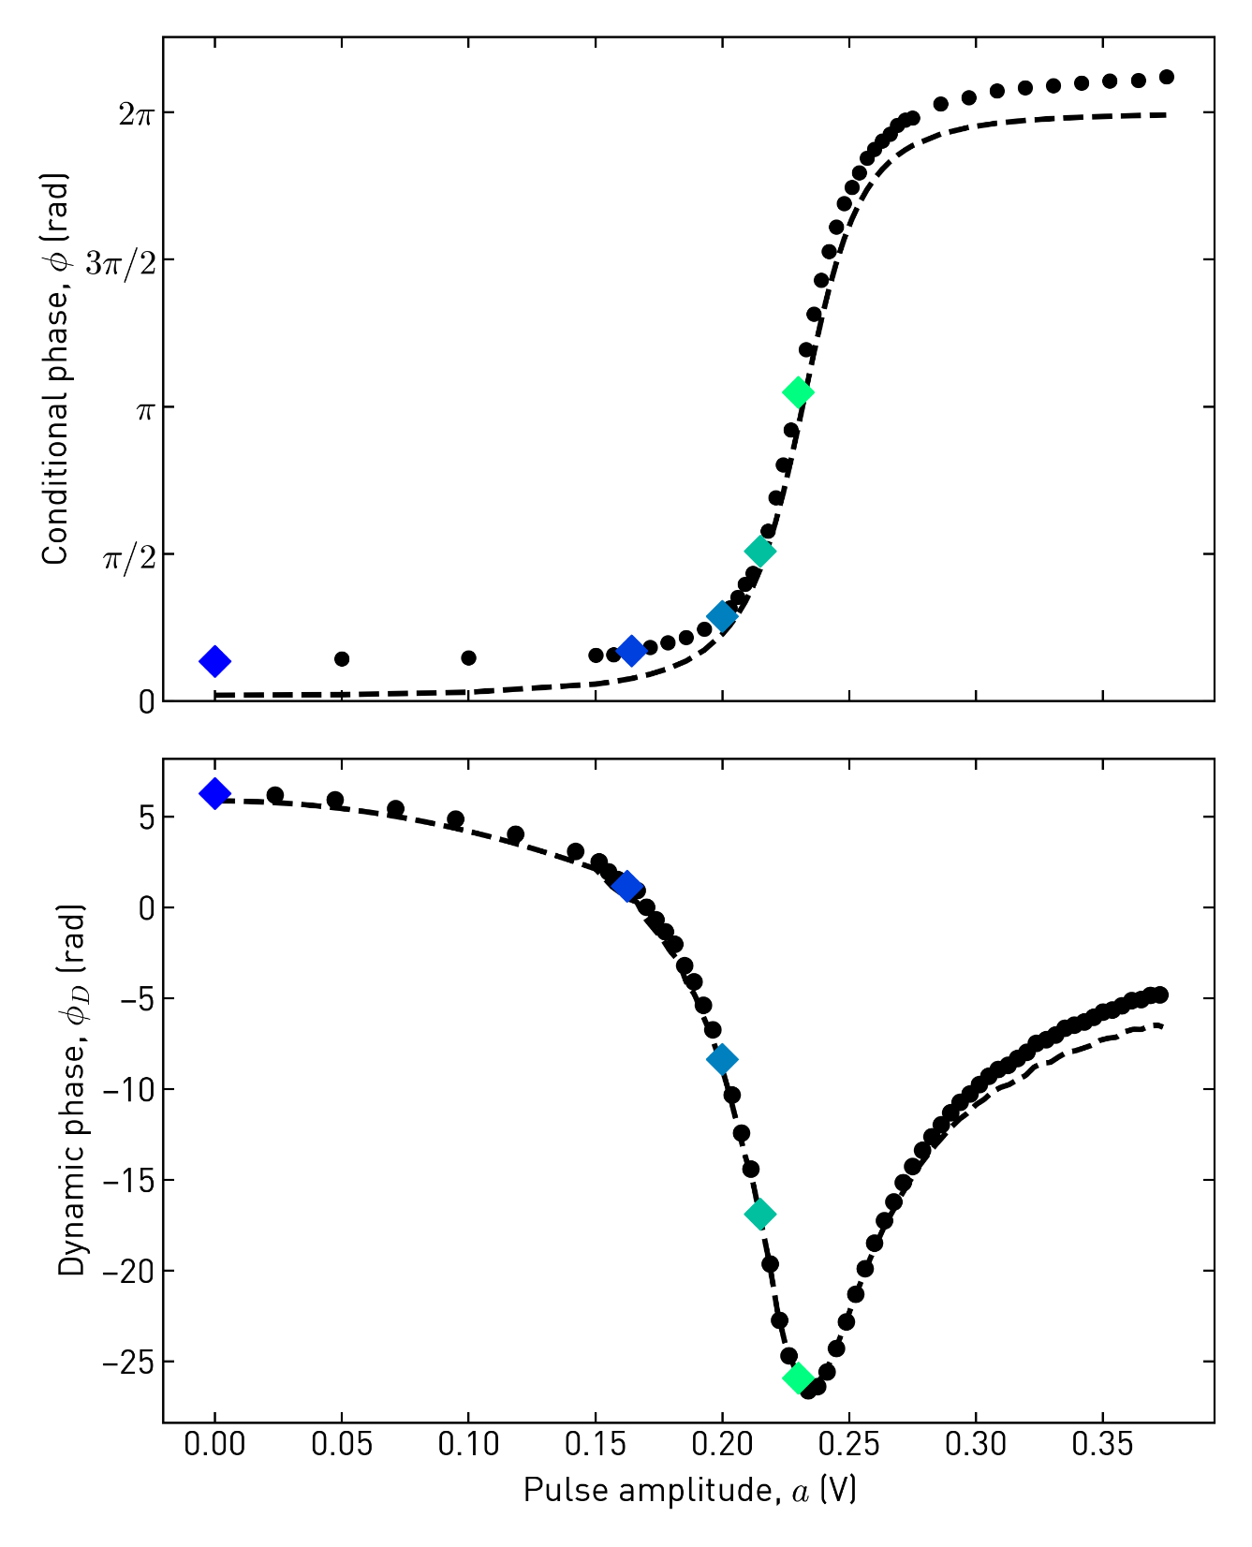
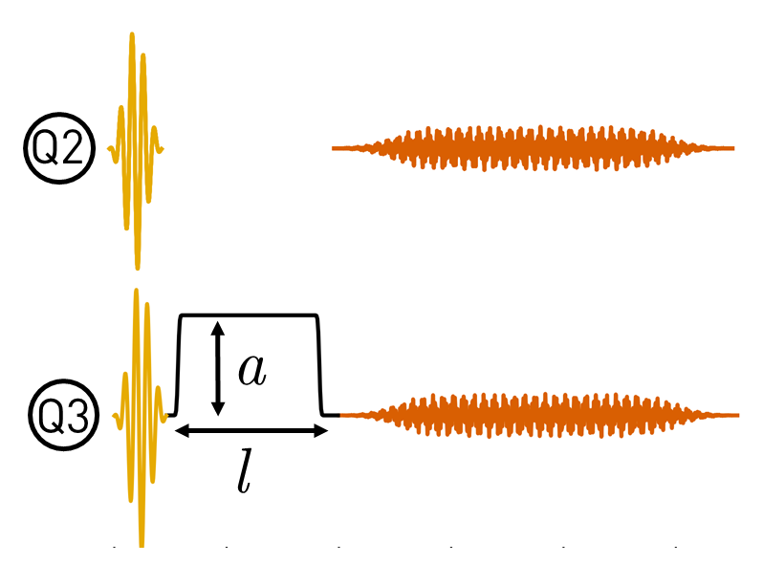
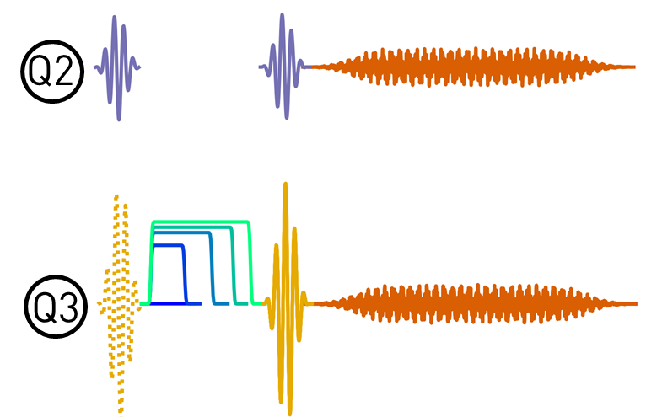
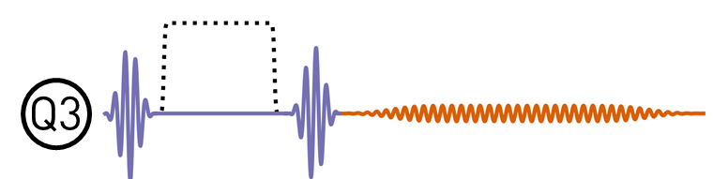
(a)
(b)
(c)

Slide 9
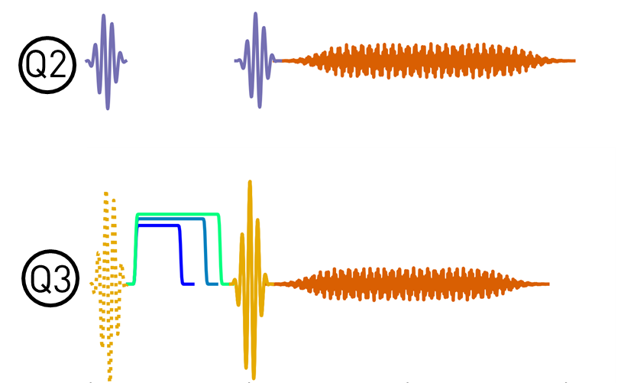
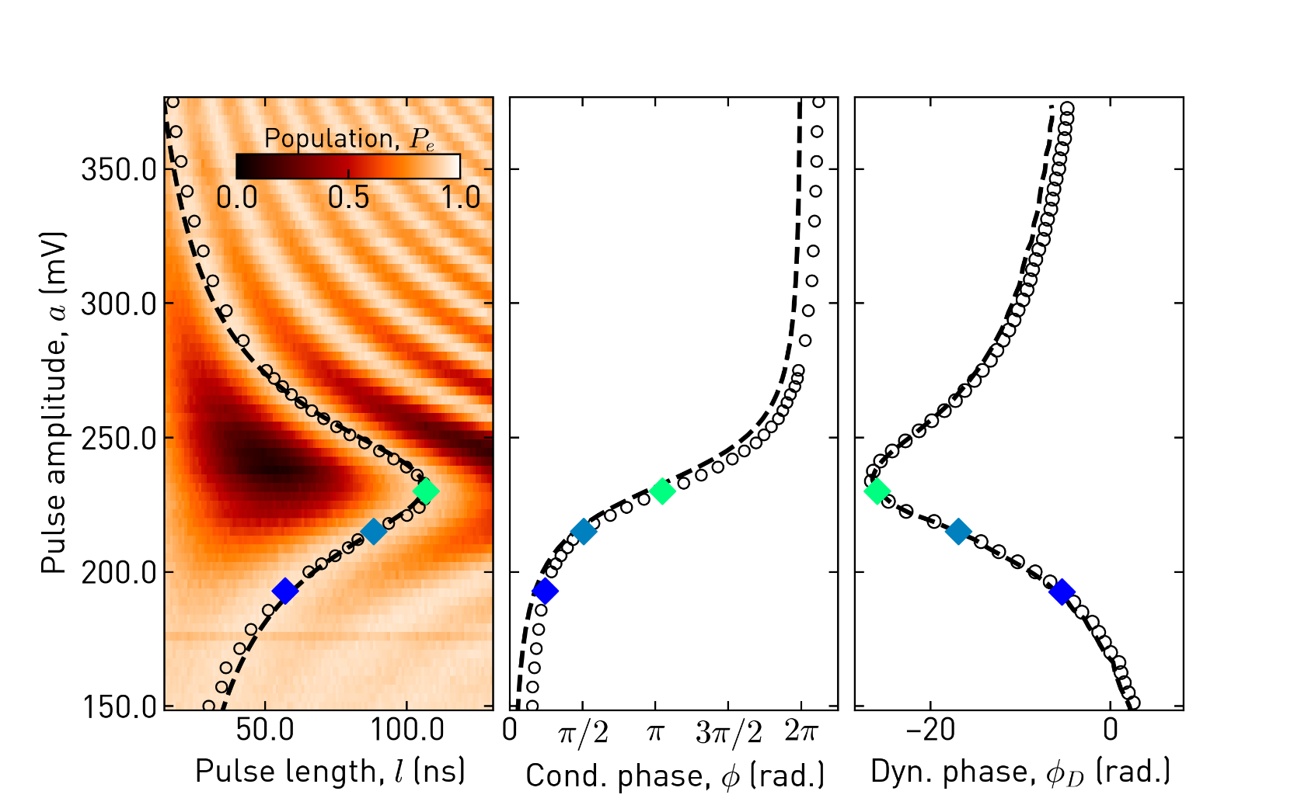

Slide 10
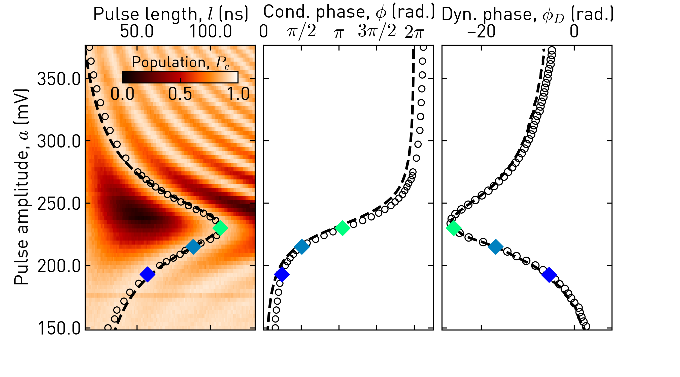

Slide 12
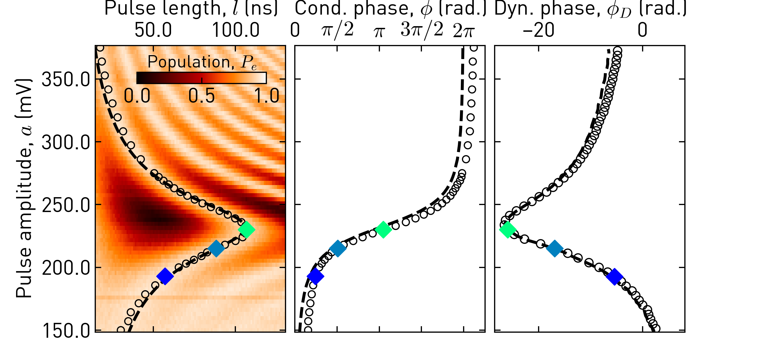
(a)
(b)
(c)
(d)
(e)
(f)

Slide 13
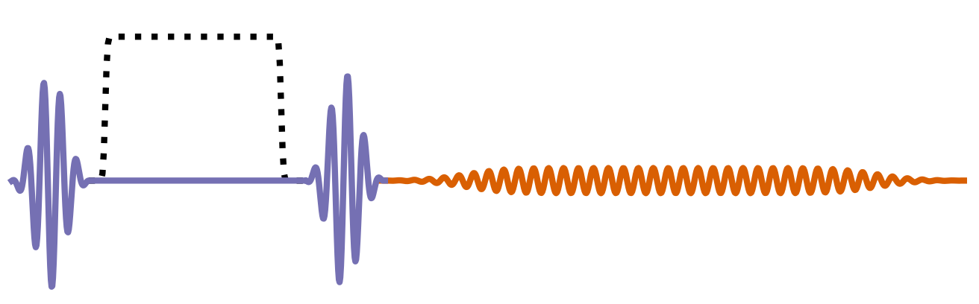
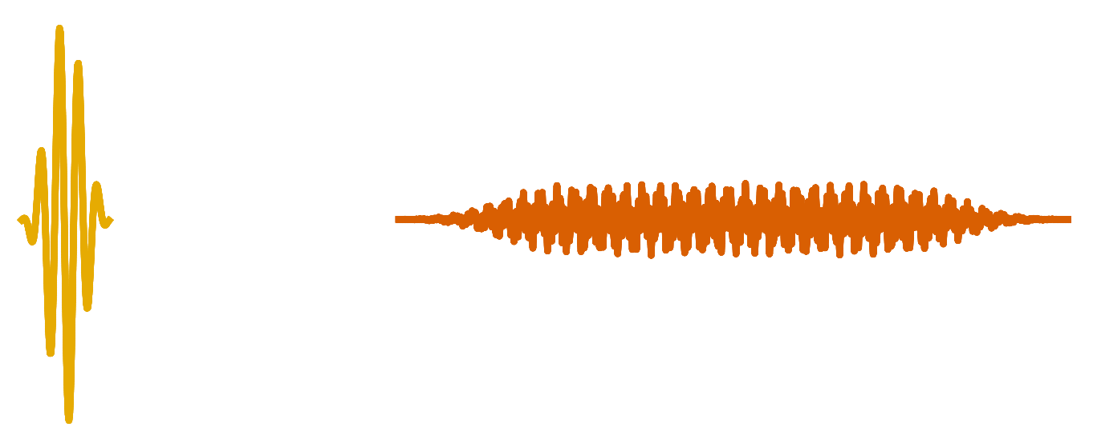

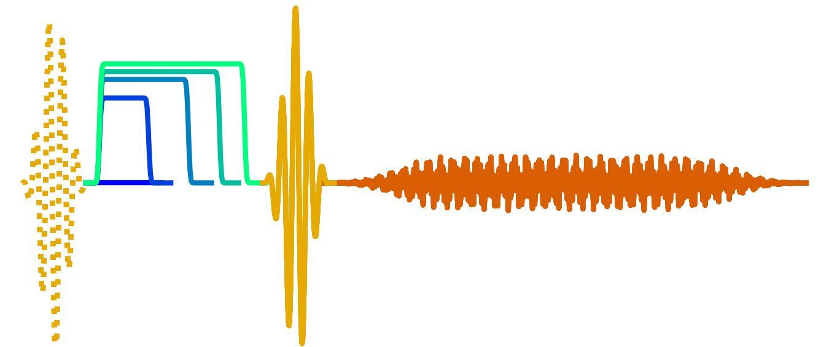
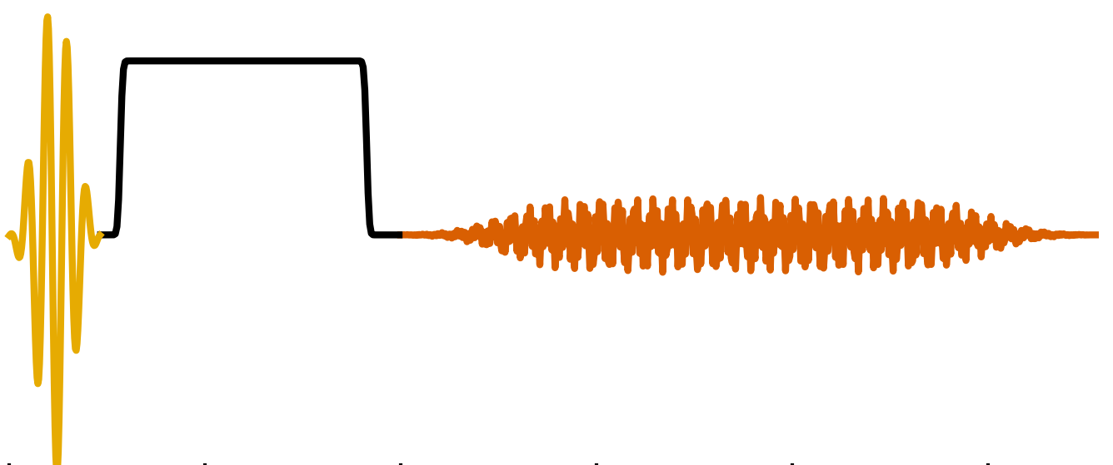
Q3
Q2
Q2
a
Q3
Q3
l

Slide 14
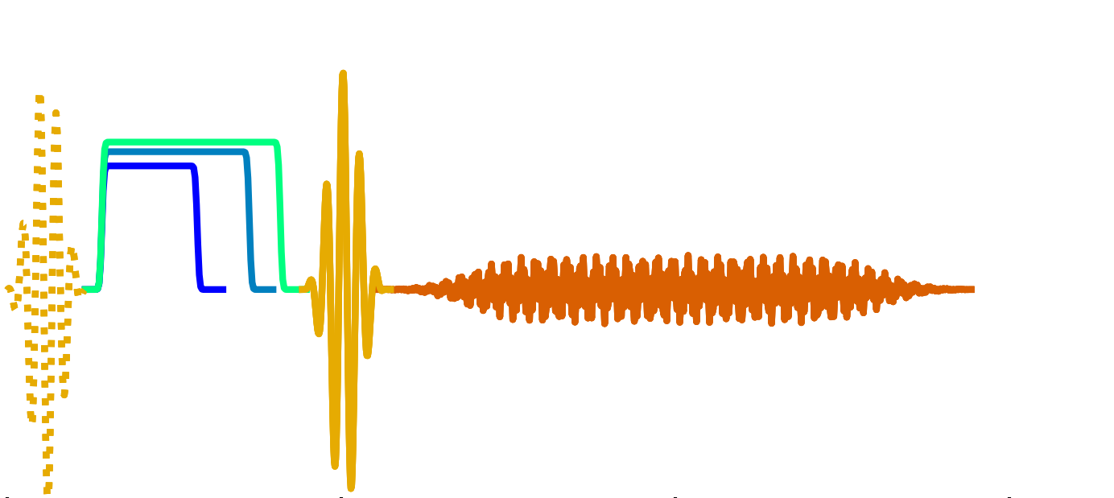
Q3
Q2
Q2
a
Q3
Q3
l

Slide 15
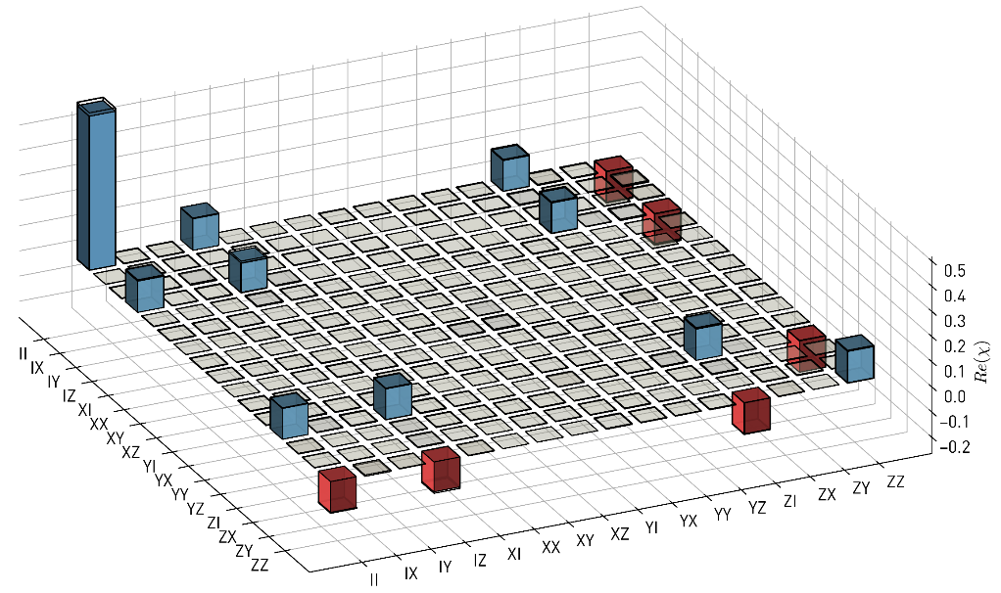
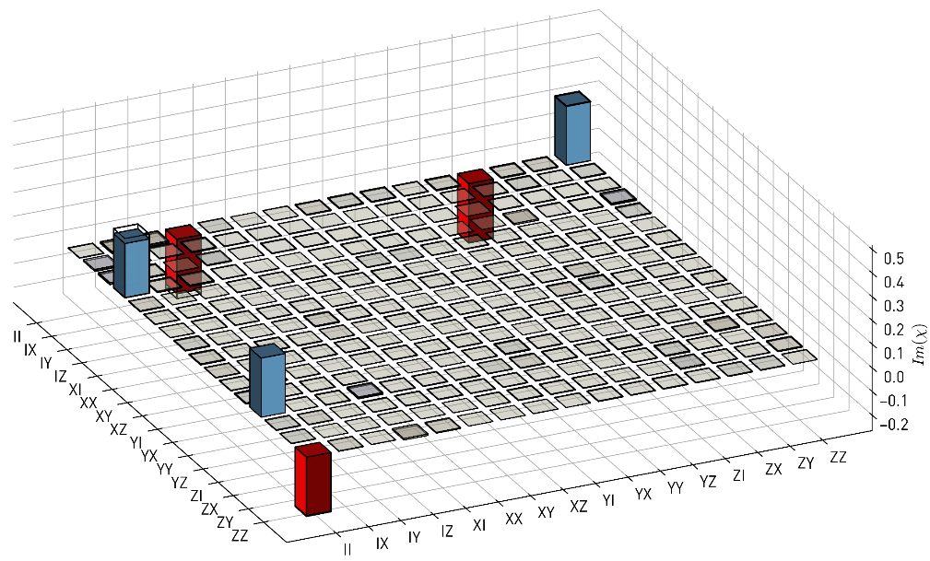
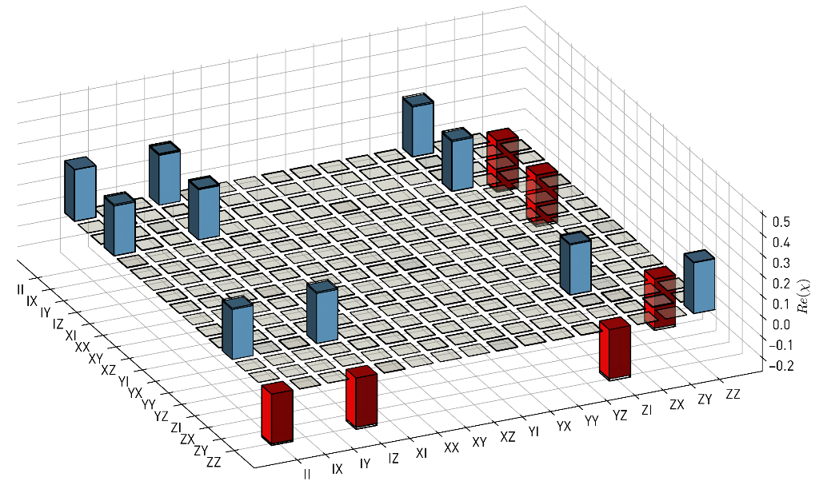
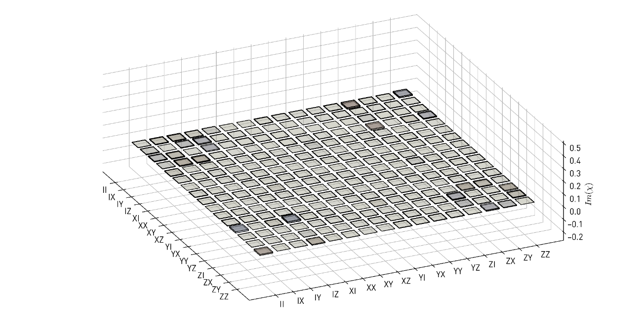
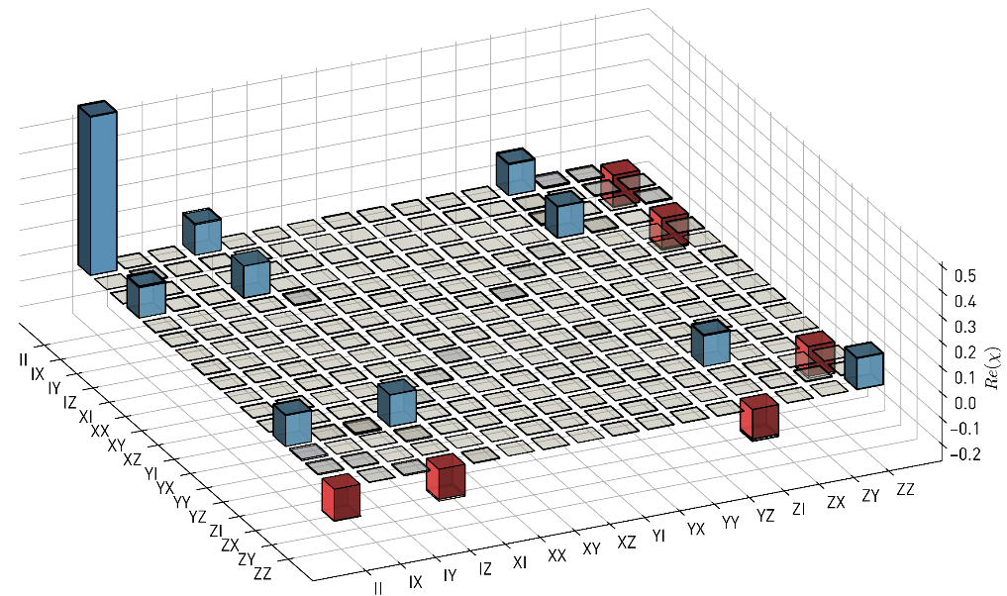
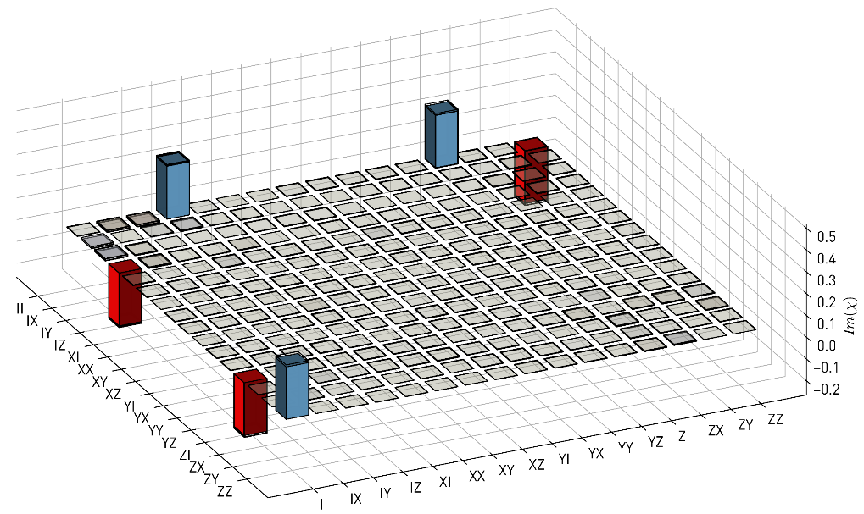
(a.1)
(a.2)
(b.1)
(b.2)
(c.1)
(c.2)

Slide 16
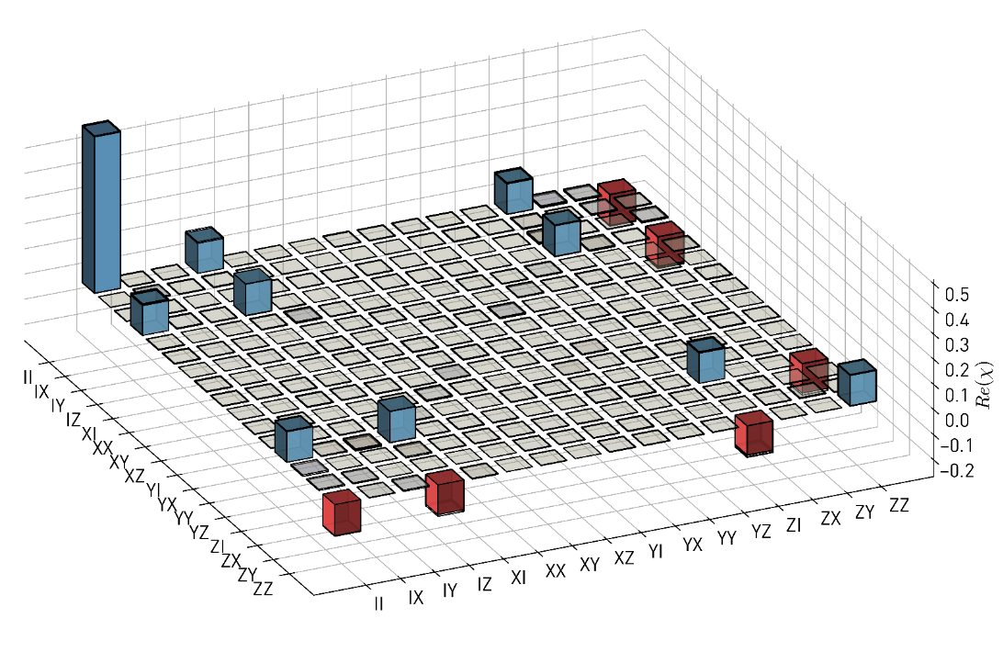
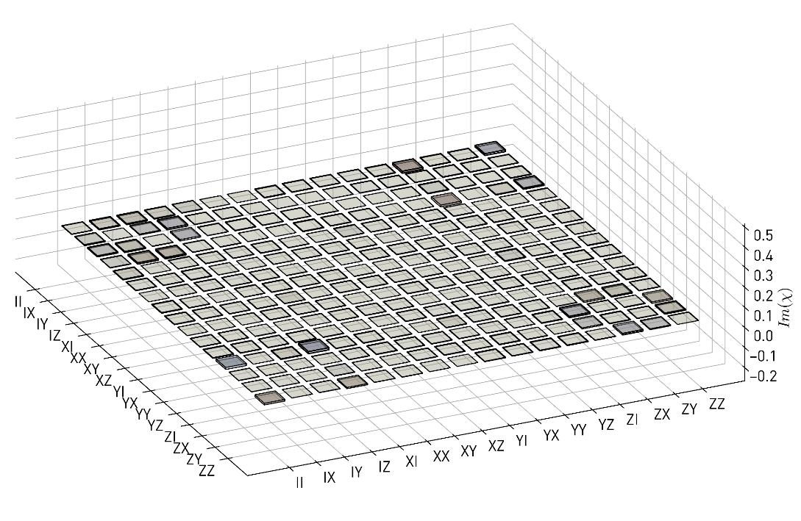


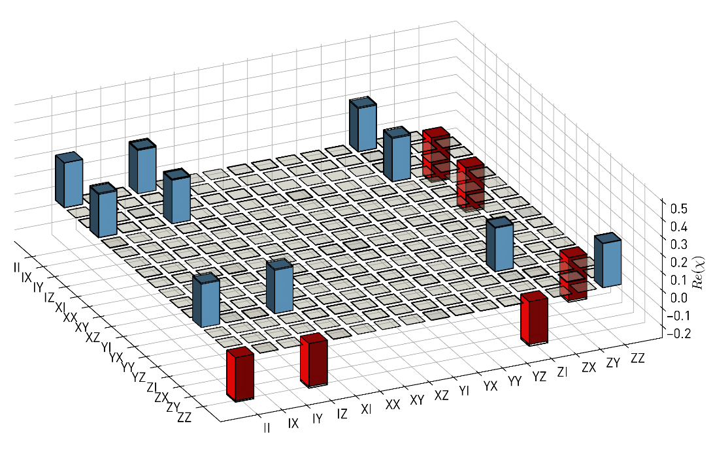
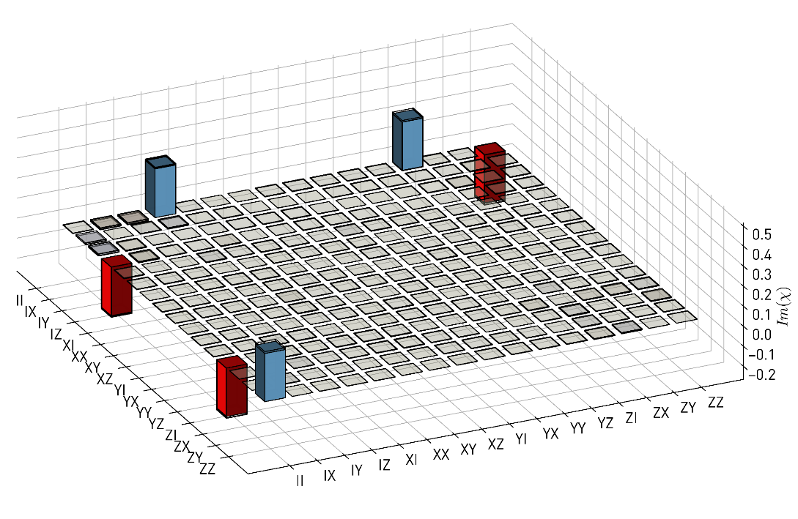


(a)
(b)
(c)
(d)

Slide 17
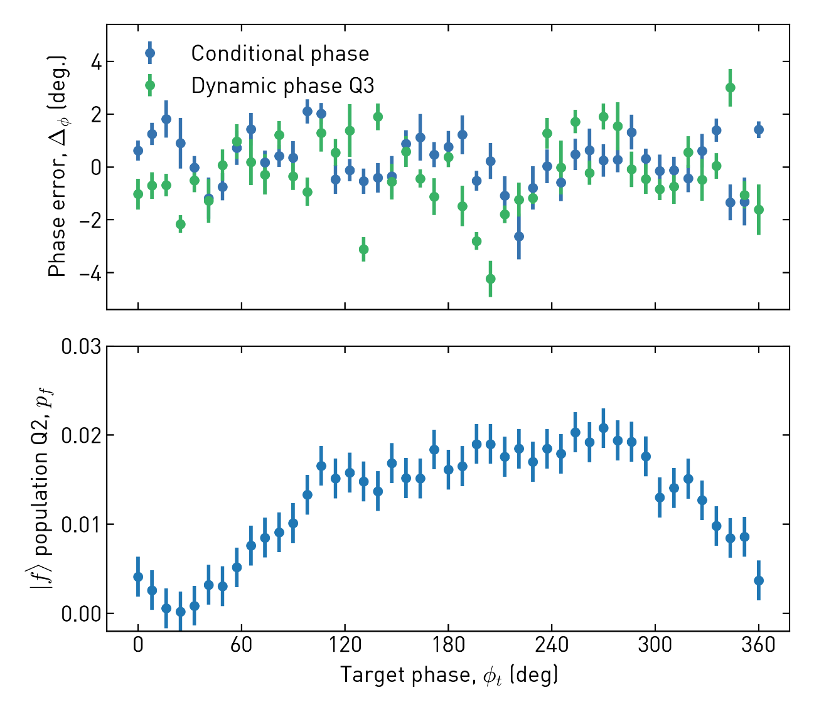
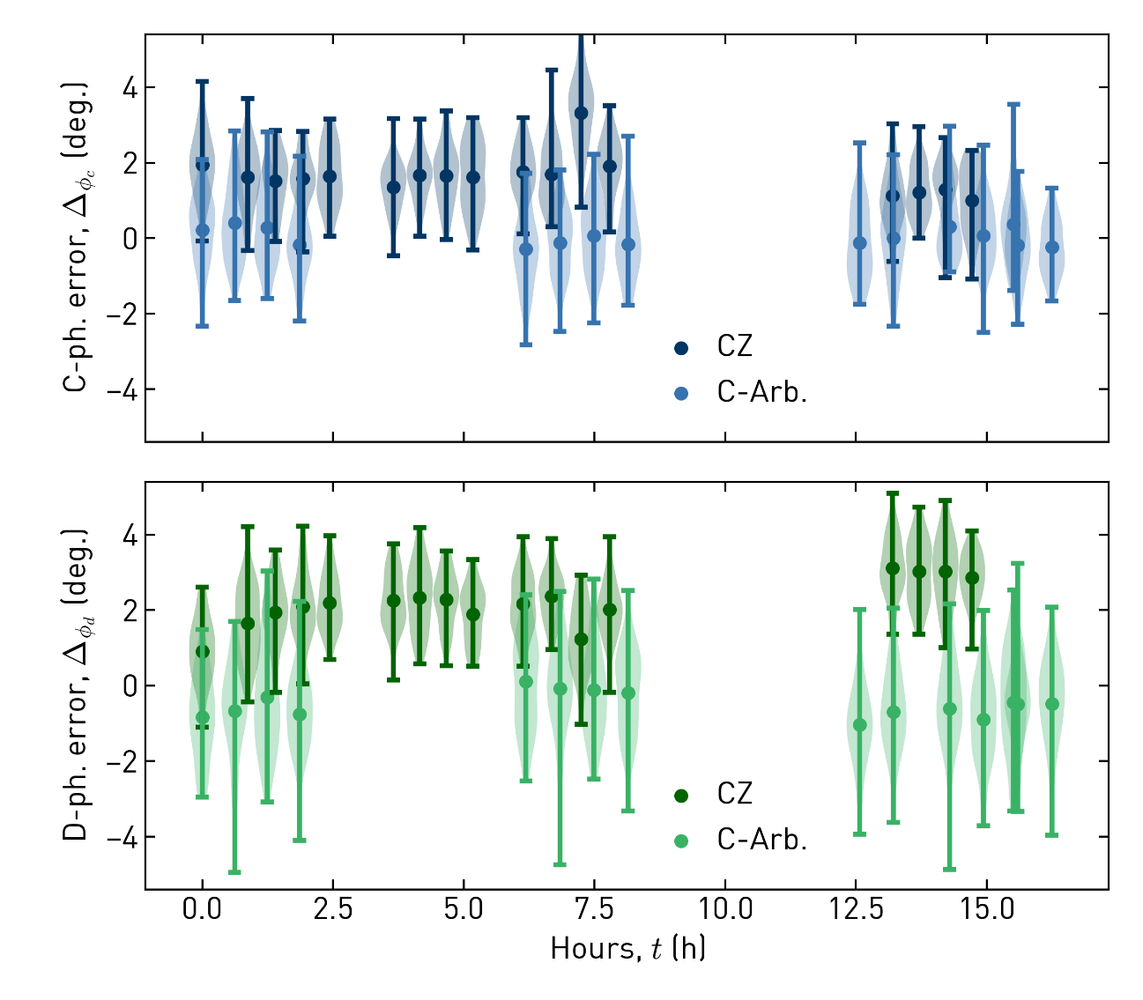

Slide 18
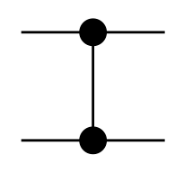
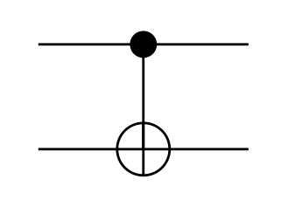
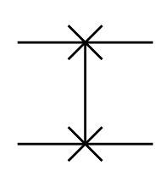


Poster figures
Quantum Computer
What QC can do
Gate set
Mathematical
problem
Quantum Algorithm
CZ
CNOT
SWAP
Quantum
Circuit
Goal and rules
Steps to follow
Decompose
CZ
CNOT
SWAP
operations

Slide 19
Quantum Computer
Mathematical
problem
Quantum Algorithm
Gate set
Quantum
Circuit
Goal and rules
Steps to follow
CZ
CNOT
SWAP
CZ
CNOT
SWAP
What QC can do
operations

Slide 20
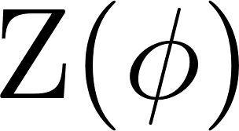
Quantum Computer
Standard gate set
Long quantum
circuit
Mathematical
problem
Variational quantum algorithm
CZ
CNOT
SWAP
CZ
CNOT
SWAP
Goal and rules
What QC can do
operations
Steps to follow
Tailored gate set
Short quantum
circuit
C-ARB

Slide 21

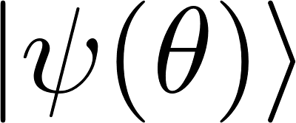
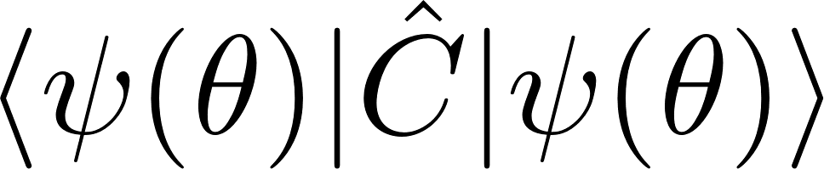

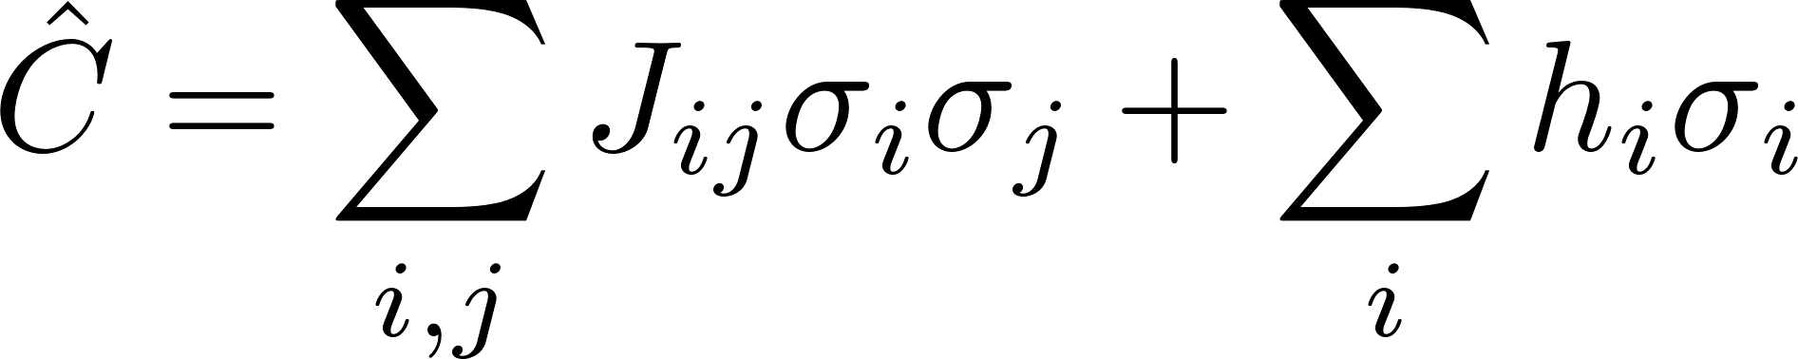
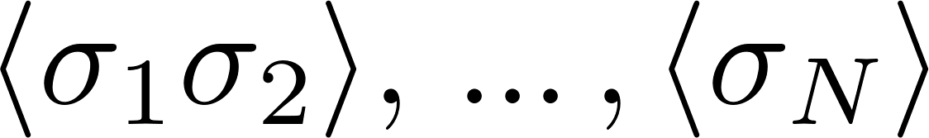

Fermionic problem
Quantum
Classical
Qubit Hamiltonian, e.g.
1. Prepare trial state
1. Compute Energy
or
Approximate
ground state
2. Measure expectation
values
2. Adjust variational
parameters
Classical optimization
problem

Slide 22


Quantum computer
Quantum chemistry problem
1. Prepare trial state
2. Measure expectation values
or
Qubit Hamiltonian, e.g.
Approximate
ground state
1. Compute Energy
Classical optimization problem
2. Adjust variational parameters
Classical computer

Slide 23
Problem
Quantum computer
1. Prepare trial state
Examples:
Quantum chemistry
Classical combinatorial optimization
2. Measure expectation values
Qubit Hamiltonian, e.g.
Approximate
ground state
1. Compute Energy
2. Adjust variational parameters
Classical computer

Slide 24
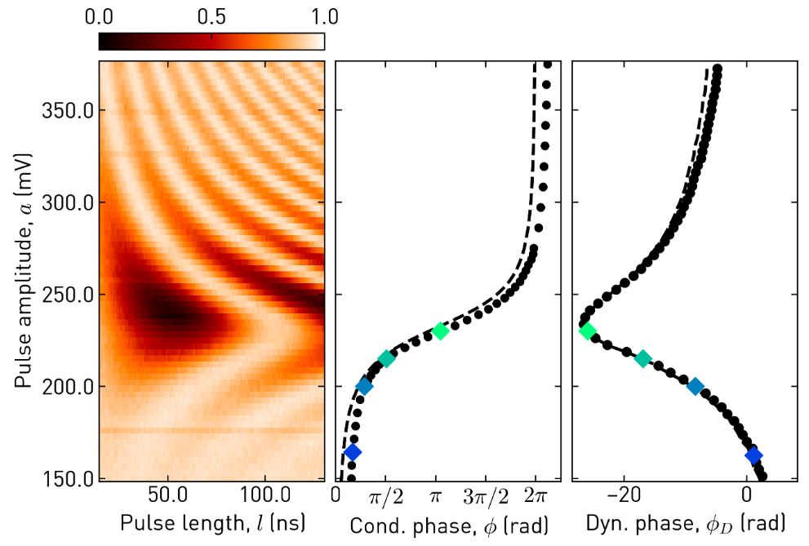

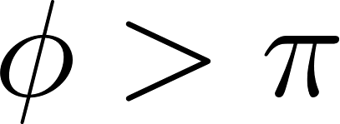

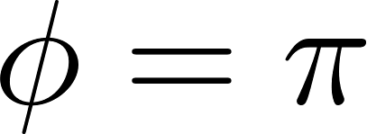

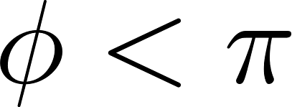
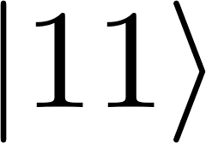

Population, p_{e}
3
1
2
Frequency, f

Slide 25
Population, p_{e}
3
1
2
Frequency, f

Slide 26
Population, p_{e}
3
1
2
Frequency, f

Slide 27




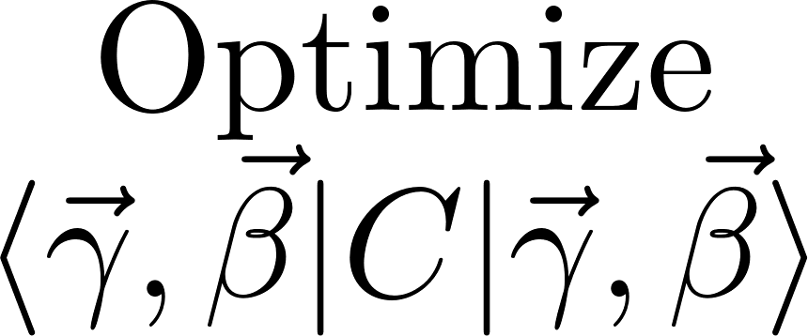

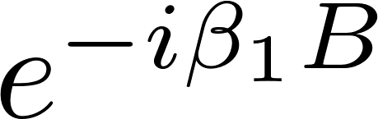

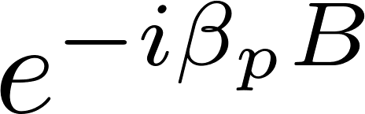
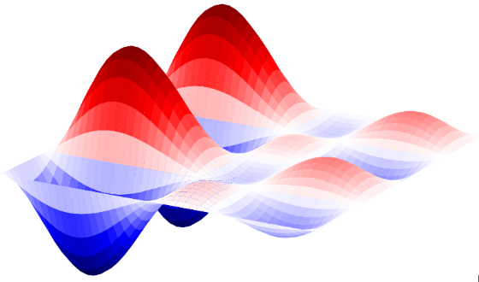

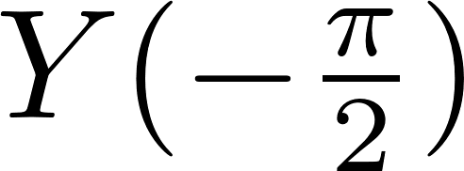
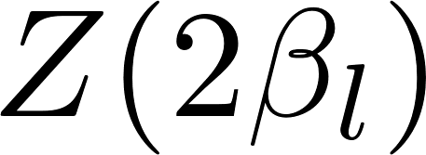





Z
Z
Z

Slide 28
Z
Z
Z

Slide 29
















Z
Z
Z
quantum computer
classical comp.

Slide 30

Z
Z
Z

Slide 31
Z
Z
Z

Slide 32
(a)
Z
Z
Z
(b)
(c)

Slide 33



(a)
(b)
(c)

Slide 34







Equations for poster

Slide 35





1
2
3
A
Q1
B
Q2
C
Q3

Slide 36
1
2
3
4
5
6
7
A
Q1
B
Q2
C
Q3
D
Q4
E
Q5
F
Q6
G
Q7

Slide 37
1
2
3
4
5
6
7
A
Q1
B
Q2
C
Q3
D
Q4
E
Q5
F
Q6
G
Q7

Slide 38



1
2
3
4
A
Q1
B
Q2
C
Q3

Slide 39
1
2
3
4
5
6
7
A
Q1
B
Q2
C
Q3
D
Q4
E
Q5
F
Q6
G
Q7

Slide 40







Slide 41

Q3
Q2
Q1
Q1

Slide 42










Slide 43
Appendices

Slide 44





R1
R2
R3
G
E
C
R4
R6
R5
F
(b)
(c)

Slide 45

R1
R2
R3
G
E
C
R4
R6
R5
F
(b)
(c)
(GHz)

Slide 46

R5
R6
R1
G
E
R2
R4
R3
F

Slide 47


(a)
(b)

